Slide 1
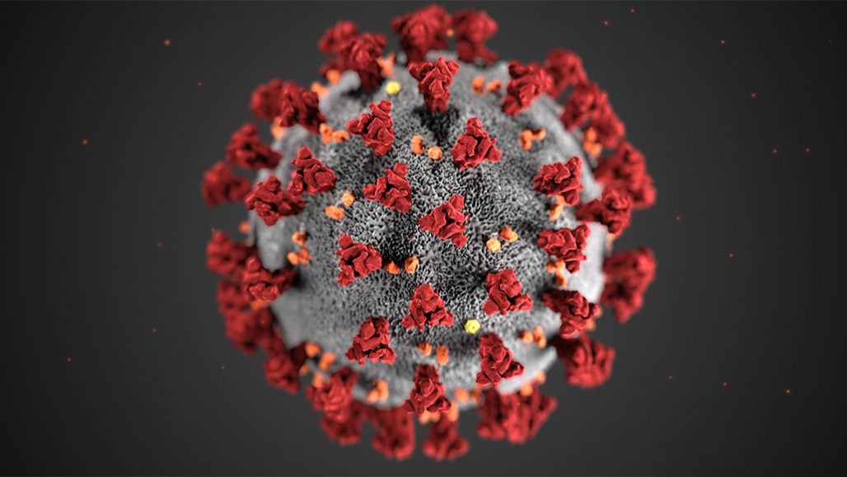
CONSPIRACY THEORIES & hoaxes ABOUT COVID-19
Adela Bundová
Kvinta

Slide 2
What is the difference between conspiracy theory and hoax?
CONSPIRACY THEORY
the belief that a secret but powerful organization is responsible for an event
HOAX
an act intended to make somebody believe something that is not true, especially something unpleasant

Slide 3
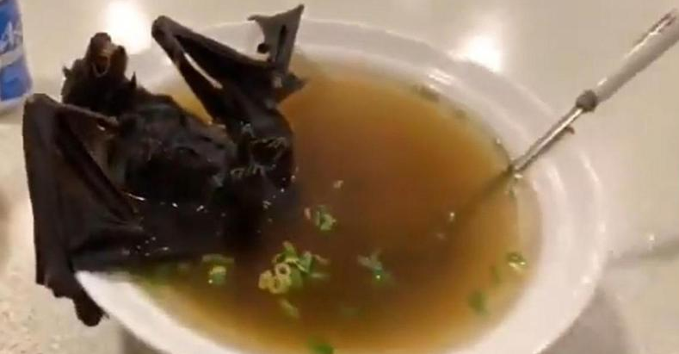
Conspiracy theories about the origins of the covid-19
Bat soup
it seems likely that the illness leapt from animals to humans
some scientists believe the animal vector may have been bats
but it is unlikely that you’d get it from eating bat soup
one of the most prominent video evidence about this theory was actually a video from travel show shot in 2016 in Palau, not China
bat soup is not a commonly eaten food in the region

Slide 4
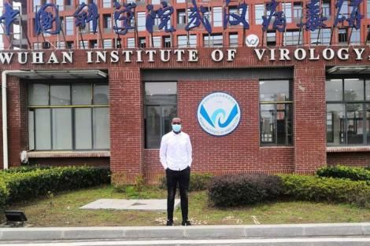
Conspiracy theories about the origins of the covid-19
Bioweapon
other popular theories include that the virus is actually a bioweapon that somehow escaped from the secure lab at Wuhan Institute of Virology
but citing a former Israeli intelligence officer who himself admits that there is no evidence to back such a theory

Slide 5
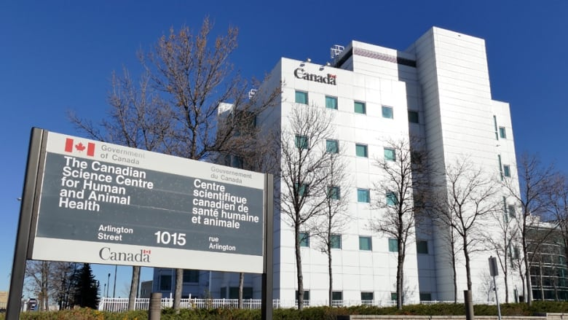
Conspiracy theories about the origins of the covid-19
Spy team
then there’s the idea that a husband and wife “spy team” of scientists stole the coronavirus from Canada’s National Microbiology Laboratory
the truth is that some virologist from the laboratory was suspended because she broke some rules bur the report doesn’t mention anything about her being a Chinese spy or sending the virus to China

Slide 6
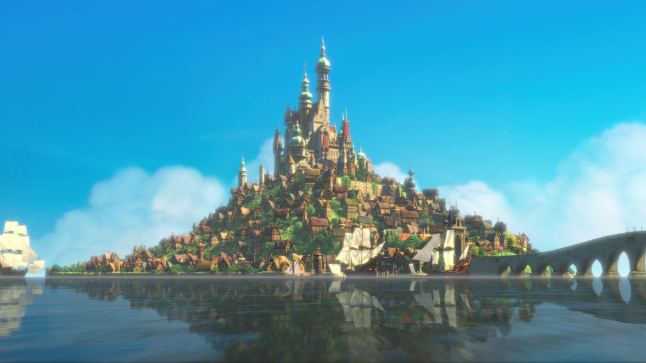
Wilder conspiracy theories about covid-19
Reducing population
this theory says, that China created the virus to reduce the number of old people in their population
World War
some people believe, that Chinese created the virus as bioweapon to attack USA and start a new world war
Disney’s future predictions
there is another conspiracy theory that Disney, especially fairytail Tangled, predicted new coronavirus
people thought that, because the main character Rapunzel was isolated her whole life from a kingdom called Corona just like new epidemic illness

Slide 7
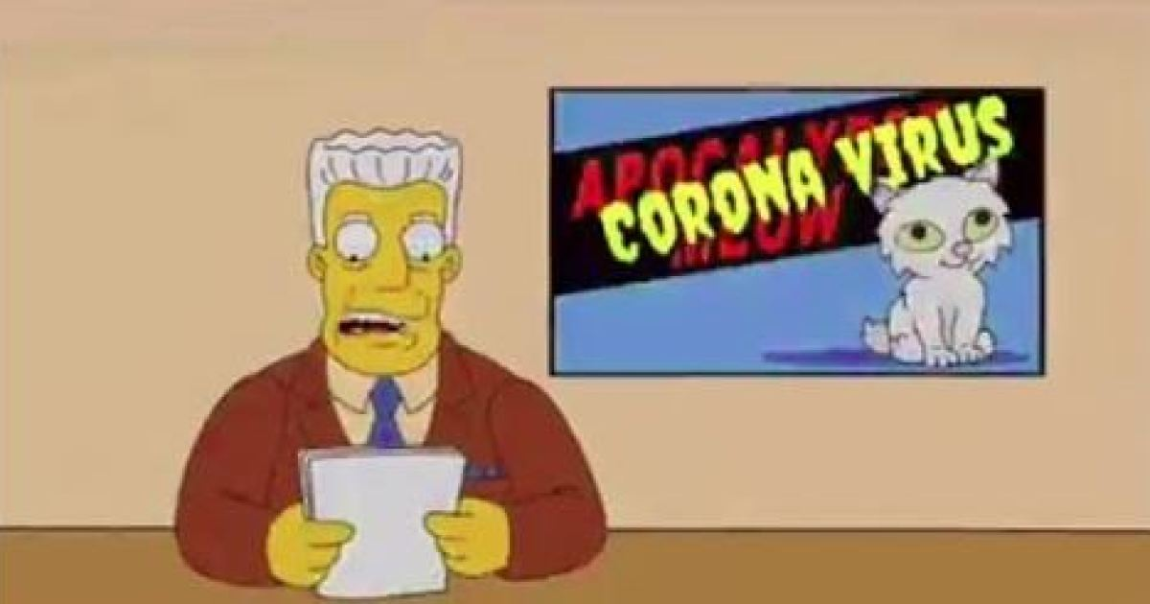
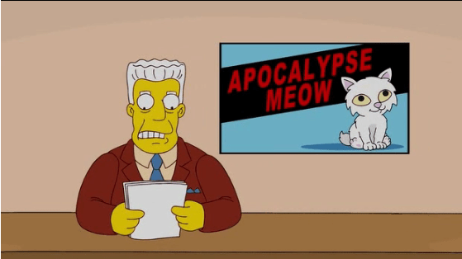
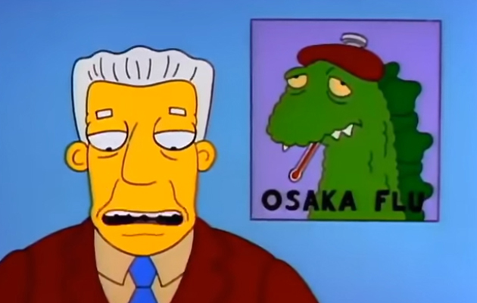
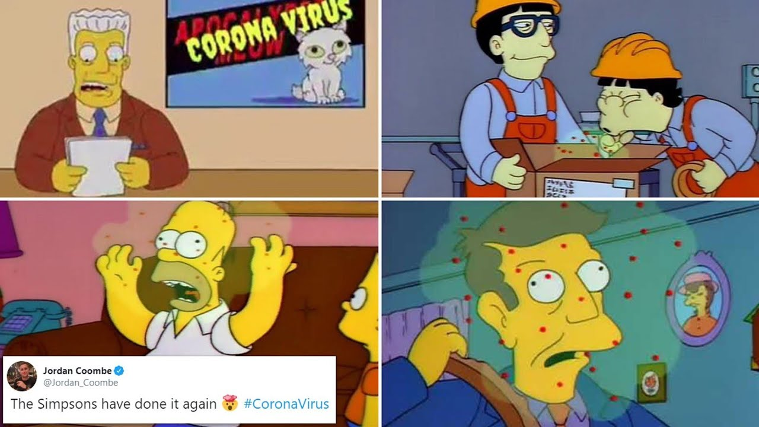
Wilder conspiracy theories about covid-19
The Simpsons’s future predictions
The Simpsons did NOT predict the new coronavirus outbreak
the episode called “Marge in chains”, which aired in 1993 does not talk about coronavirus, but about the fictional disease “Osaka flu”
images on social media have been edited to make it look like the episode was about coronavirus

Slide 8
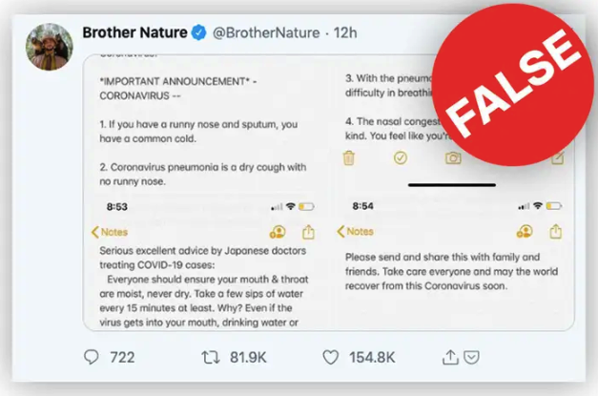
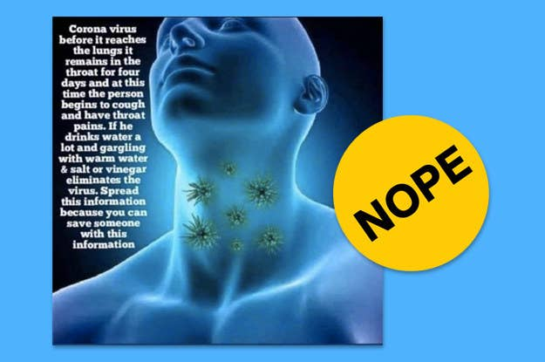
Hoaxes about covid-19
You don’t get coronavirus if you avoid eating spicy and cold food
You should eat hot food and hot water to protect yourself from coronavirus
You should drink water every 15 minutes
The virus remains in your throat for 4 days before it reaches to the lungs

Slide 9
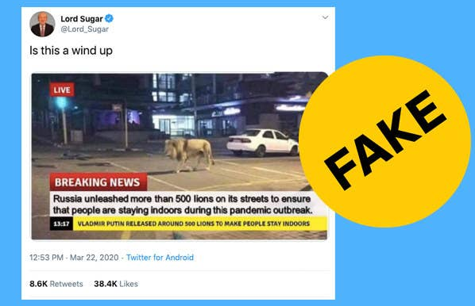
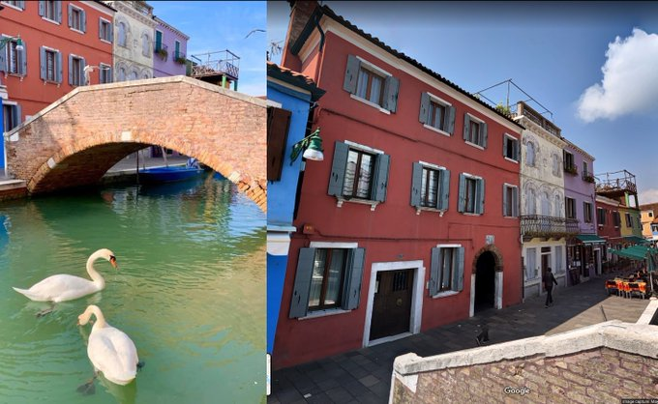
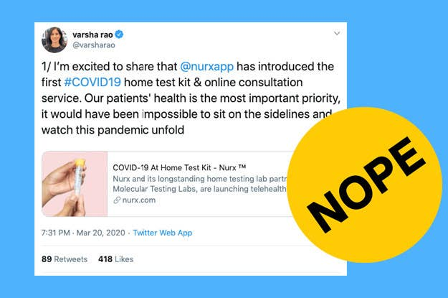
Hoaxes about covid-19
Lions on the streets in Russia
Home testing kits for Covid-19
Dolphins and swans in the Venice
https://twitter.com/i/status/1239863383354224641

Slide 10
reSOurces
https://www.wired.com/story/coronavirus-conspiracy-theories/
https://www.buzzfeednews.com/article/janelytvynenko/coronavirus-fake-news-disinformation-rumors-hoaxes
https://www.nationalgeographic.com/animals/2020/03/coronavirus-pandemic-fake-animal-viral-social-media-posts/
https://www.oxfordlearnersdictionaries.com/definition/english/hoax_1?q=hoax

Slide 11
THANK YOU FOR YOUR ATTENTION

